Slide 1
Introduction to
Epidemiology
APHS 20203 • Epidemiology & Biostatistics

Slide 2
APHS 20203
Epidemiology & Biostatistics
Learning objectives
Unpack the definition and assumptions of epidemiology
1
Identify key events in the history of epidemiology
2
Distinguish between disease distribution patterns: epidemics, endemics, and pandemics
3
Describe at least three uses of epidemiology
LEARNING OBJECTIVES
12

Slide 3
APHS 20203
Epidemiology & Biostatistics
Exercise
1
All of the following illustrate the purpose of epidemiology in public health, except
2
A. identifying populations who are at risk for certain diseases.
B. assessing the effectiveness of interventions.
3
✓ C. providing treatment for patients in clinical settings.
D. determining the importance of causes of illness
CHECK FOR UNDERSTANDING
13
Notes:
[Sources]
- Yan Zhang, APHS 20203 W1-Overview and Epi Intro.pptx, source slide 13.
[/Sources]

Slide 4
APHS 20203
Epidemiology & Biostatistics
Exercise
1
Epidemiologists use a model for studying infectious disease and its spread that involves the microbe that causes the disease, the organism that harbors the disease, and the external factors that cause or allow disease transmission. This is also known as
2
A. host, vector, and transmission.
B. transmission, host, and environment.
3
✓ C. organism, transmission, and environment.
D. host, agent, and environment.
CHECK FOR UNDERSTANDING
14
Notes:
[Sources]
- Yan Zhang, APHS 20203 W1-Overview and Epi Intro.pptx, source slide 14.
[/Sources]

Slide 5
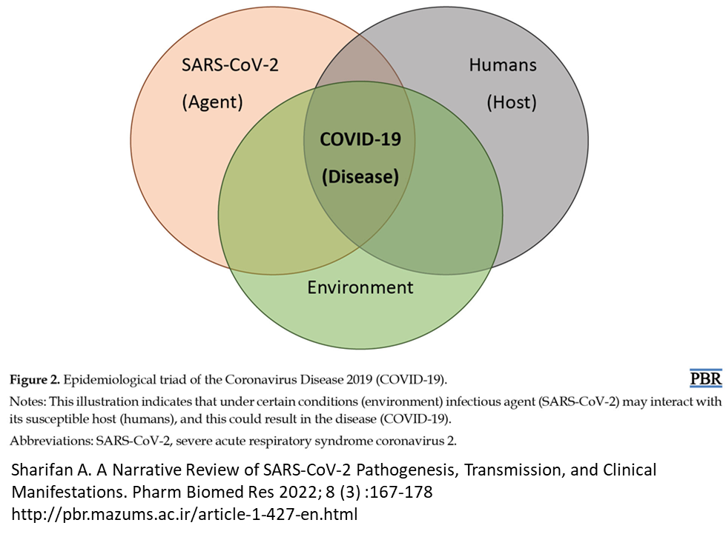
APHS 20203
Epidemiology & Biostatistics
What is Epidemiology?
EPIDEMIOLOGY
epi -- “on, upon”
demo -- “people”
ology -- “study of”
Definition: the study of the distribution and determinants of health-related states or events (e.g. infectious disease) in specified (human) populations and the application of this study to control health problems
--- James Last, 1995, A Dictionary of Epidemiology
DEFINITION
15
Notes:
[Sources]
- Yan Zhang, APHS 20203 W1-Overview and Epi Intro.pptx, source slide 15.
- Inherited epidemiologic-triad figure and citation as embedded in the source slide.
[/Sources]

Slide 6
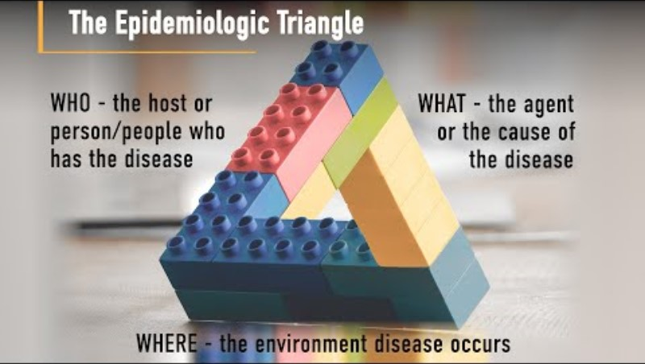
APHS 20203
Epidemiology & Biostatistics
The Epidemiologic Triangle
EPIDEMIOLOGIC TRIANGLE
16
Notes:
[Sources]
- Yan Zhang, APHS 20203 W1-Overview and Epi Intro.pptx, source slide 16.
- Inherited epidemiologic-triangle image as embedded in the source slide.
[/Sources]

Slide 7
APHS 20203
Epidemiology & Biostatistics
Scenario Exercise
1
Scenario:
A city health department notices that one neighborhood has twice the rate of asthma ER visits compared to another neighborhood in the same city. This difference has been observed every year for the past three years.
2
Questions:
Do you think this difference is mostly due to random chance—yes or no?
If it’s not random, what is one thing that might explain the difference?
3
What are we assuming if we believe those factors matter?
SCENARIO EXERCISE
17
Notes:
[Sources]
- Yan Zhang, APHS 20203 W1-Overview and Epi Intro.pptx, source slide 17.
[/Sources]

Slide 8
APHS 20203
Epidemiology & Biostatistics
Assumptions of Epidemiology
ASSUMPTION 1
ASSUMPTION 2
Human disease does not occur at random
Determinants of disease can be identified
Disease frequency and distribution vary because of identifiable factors that increase or decrease risk.
Causal and preventive factors can be studied through systematic investigation of populations.
ASSUMPTIONS
18
Notes:
[Sources]
- Yan Zhang, APHS 20203 W1-Overview and Epi Intro.pptx, source slide 18.
[/Sources]

Slide 9
APHS 20203
Epidemiology & Biostatistics
Descriptive and Analytic Epidemiology
DISTRIBUTION
DETERMINANTS
Descriptive epidemiology
Analytic epidemiology
When was the population affected?
Where was the population affected?
Who was affected?
How was the population affected?
Why was the population affected?
Descriptive Epidemiology Is A Necessary Antecedent Of Analytic Epidemiology
19
Notes:
[Sources]
- Yan Zhang, APHS 20203 W1-Overview and Epi Intro.pptx, source slide 19.
[/Sources]

Slide 10

APHS 20203
Epidemiology & Biostatistics
Cholera Outbreak In London
Cholera Symptoms
Cholera is an extremely virulent disease that can cause severe acute watery diarrhea.
Cholera affects both children and adults and can kill within hours if untreated.
It takes between 12 hours and 5 days for a person to show symptoms after ingesting contaminated food or water.
HISTORICAL EXAMPLE
20
Notes:
[Sources]
- Yan Zhang, APHS 20203 W1-Overview and Epi Intro.pptx, source slide 20.
- Inherited book-cover image as embedded in the source slide.
[/Sources]

Slide 11
APHS 20203
Epidemiology & Biostatistics
Micro-Activity: Thinking Like an Epidemiologist
1
Watch the short video on John Snow and cholera.
John Snow: Pioneer of Epidemiology
2
As you watch, focus on these questions:
What patterns did Snow observe?
(Who, where, when — descriptive epidemiology)
3
What explanation was he testing?
(How, why — analytic epidemiology)
Descriptive epidemiology comes first, analytic epidemiology builds on it.
MICRO-ACTIVITY
21
Notes:
[Sources]
- Yan Zhang, APHS 20203 W1-Overview and Epi Intro.pptx, source slide 21.
- PBS LearningMedia, John Snow: Pioneer of Epidemiology, https://kera.pbslearningmedia.org/resource/envh10.sci.life.nathis.johnsnow/john-snow-pioneer-of-epidemiology/ (inherited link).
[/Sources]

Slide 12
APHS 20203
Epidemiology & Biostatistics
History of Epidemiology: Key Events
Event | Time Period | Description
Bubonic Plague Epidemics (Black Death) | 1347 - 1351 | One of the deadliest pandemics, causing 75–200 million deaths in Eurasia.
Development of Toxicology | 16th Century | Paracelsus, "Father of Toxicology," introduced the principle: "The dose makes the poison."
Development of Biostatistics | 18th Century | John Graunt pioneered statistical analysis, using Bills of Mortality to study disease patterns in London.
Development of Smallpox Vaccine | 1796 | Edward Jenner created the first vaccine by using cowpox to confer immunity to smallpox.
1918 Influenza Pandemic | 1918-19 | The "Spanish flu" infected a third of the global population, killing 50–100 million.
Identification of Smoking as a Cause of Cancer | 1950 | Landmark studies linked smoking to lung cancer, driving public health campaigns against tobacco use.
Eradication of Smallpox | 1980 | WHO declared smallpox eradicated, marking the success of global vaccination efforts.
HISTORY / KEY EVENTS
22
Notes:
[Sources]
- Yan Zhang, APHS 20203 W1-Overview and Epi Intro.pptx, source slide 22.
[/Sources]

Slide 13
APHS 20203
Epidemiology & Biostatistics
Renowned Epidemiology Scholars
How Epidemiologists Learned to Think:
Hippocrates → Environment and behavior influence health
John Graunt → Counting populations reveals disease patterns
William Farr → Vital statistics and surveillance systems
John Snow → Using population data to identify causes
Alexander Louis → Quantitative reasoning in medicine
Bradford Hill → Systematic thinking about causality
HISTORY / SCHOLARS
23
Notes:
[Sources]
- Yan Zhang, APHS 20203 W1-Overview and Epi Intro.pptx, source slide 23.
[/Sources]

Slide 14
APHS 20203
Epidemiology & Biostatistics
The Contemporary Era: 1940 to Present
01
02
03
Long-term population studies
Expanded causal thinking
Ethics and equity in research
Framingham Heart Study → identification of risk factors
Chronic disease linked to behaviors, infections, and genetics
William Carter Jenkins → accountability in public health studies
CONTEMPORARY ERA
24
Notes:
[Sources]
- Yan Zhang, APHS 20203 W1-Overview and Epi Intro.pptx, source slide 24.
[/Sources]

Slide 15
APHS 20203
Epidemiology & Biostatistics
From History to Practice
Epidemiology began by asking:
Who is affected?
Where does disease occur?
When does it change over time?
Next: Applying these questions to real data
(Person, Place, and Time)
FROM HISTORY TO PRACTICE
25
Notes:
[Sources]
- Yan Zhang, APHS 20203 W1-Overview and Epi Intro.pptx, source slide 25.
[/Sources]

Slide 16
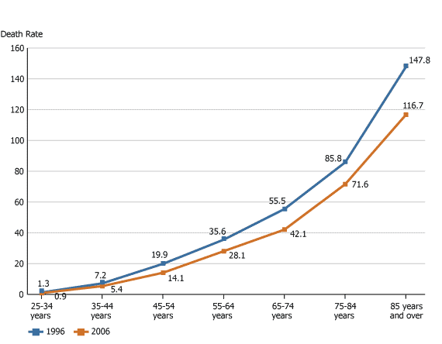
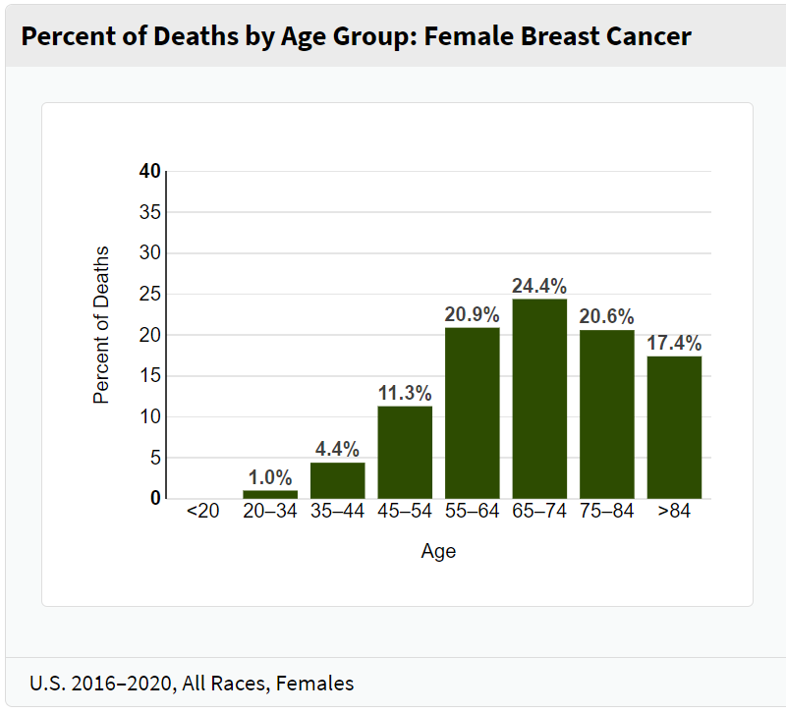
APHS 20203
Epidemiology & Biostatistics
Who: personal characteristics e.g. age or gender
Age-Specific Death Rates Associated With Breast Cancer Among All Persons by Age Group, United States, 1996 and 2006
Note: The death rates refer to the number of deaths due to breast cancer per 100,000 persons in the particular age group (including both females and males). Source: National Center for Health Statistics. Available at http://www.prb.org/Articles/2009/breastcancer.aspx?p=1
PERSON
26
Notes:
[Sources]
- Yan Zhang, APHS 20203 W1-Overview and Epi Intro.pptx, source slide 26.
- Inherited breast-cancer charts and visible source note as embedded in the source slide.
[/Sources]

Slide 17
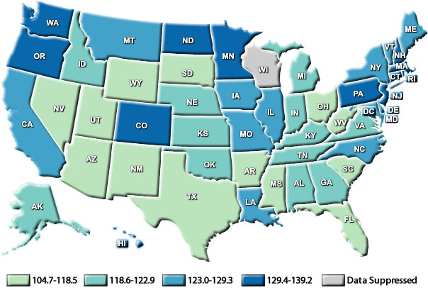
APHS 20203
Epidemiology & Biostatistics
Where: Geographically restricted or widespread (pandemic)?
Female Breast Cancer Incidence Rates* by State, 2009†
*Rates are per 100,000 and are age-adjusted to the 2000 U.S. standard population. ‡Data are suppressed at the state's request. †Source: U.S. Cancer Statistics Working Group. United States Cancer Statistics: 1999–2009 Incidence and Mortality Web-based Report. Atlanta (GA): Department of Health and Human Services, Centers for Disease Control and Prevention, and National Cancer Institute; 2013. Available at: http://www.cdc.gov/cancer/breast/statistics/state.htm
PLACE
27
Notes:
[Sources]
- Yan Zhang, APHS 20203 W1-Overview and Epi Intro.pptx, source slide 27.
- Inherited map and visible source note as embedded in the source slide.
[/Sources]

Slide 18
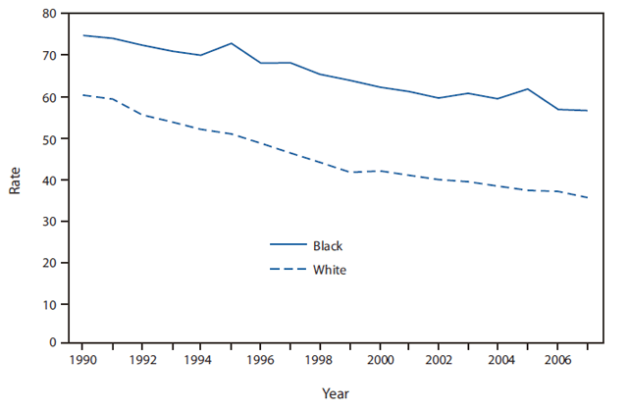
APHS 20203
Epidemiology & Biostatistics
When: change over time
Breast Cancer Death Rates Among Women Aged 45--64 Years,* by Race --- United States, 1990--2007
* Rates per 100,000 women aged 45--64 years for whom breast cancer was the underlying cause of death (based on International Classification of Diseases, Ninth Revision [ICD-9] codes 174--175 for 1990--1998 and ICD-10 code C50 for 1999--2007). Sources: CDC Morbidity and Mortality Weekly Report (MMWR), July 30, 2010 / 59(29);915. Available at http://www.cdc.gov/mmwr/preview/mmwrhtml/mm5929a5.htm
TIME
28
Notes:
[Sources]
- Yan Zhang, APHS 20203 W1-Overview and Epi Intro.pptx, source slide 28.
- Inherited time-series chart and visible source note as embedded in the source slide.
[/Sources]

Slide 19
APHS 20203
Epidemiology & Biostatistics
From Patterns to Classification
01
02
03
Endemic
Epidemic
Pandemic
We use person, place, and time to describe disease patterns. These patterns are commonly classified as endemic, epidemic, and pandemic. These terms describe patterns over time and place, not disease severity.
CLASSIFICATION
29
Notes:
[Sources]
- Yan Zhang, APHS 20203 W1-Overview and Epi Intro.pptx, source slide 29.
[/Sources]

Slide 20
APHS 20203
Epidemiology & Biostatistics
Disease Distribution Patterns
01
02
03
Endemic
Epidemic (Outbreak)
Pandemic
Disease or condition consistently present in a population
• Relatively stable over time
• Expected level of occurrence in a given place
Disease occurrence in excess of what is normally expected
• Sudden increase over a short period
• Often limited to a specific region
An epidemic that spreads across multiple countries or continents
• Global distribution
• Affects a large proportion of the population
DISEASE DISTRIBUTION
30
Notes:
[Sources]
- Yan Zhang, APHS 20203 W1-Overview and Epi Intro.pptx, source slide 30.
[/Sources]

Slide 21
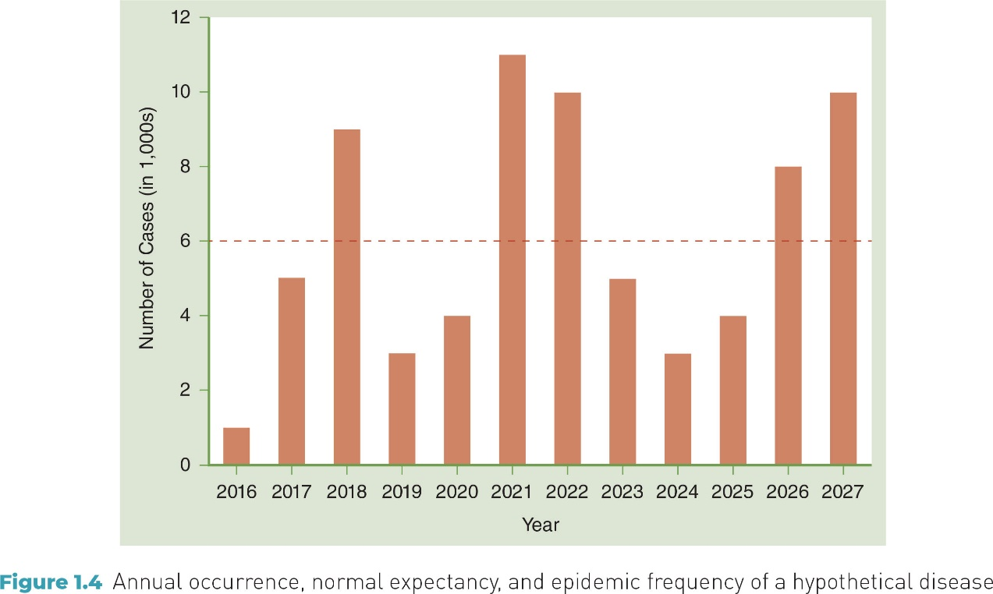
APHS 20203
Epidemiology & Biostatistics
Epidemic: Visual Illustration
epidemic frequency
normal expectancy
Annual occurrence
EPIDEMIC / VISUAL
31
Notes:
[Sources]
- Yan Zhang, APHS 20203 W1-Overview and Epi Intro.pptx, source slide 31.
- Inherited epidemic illustration and annotations as embedded in the source slide.
[/Sources]

Slide 22
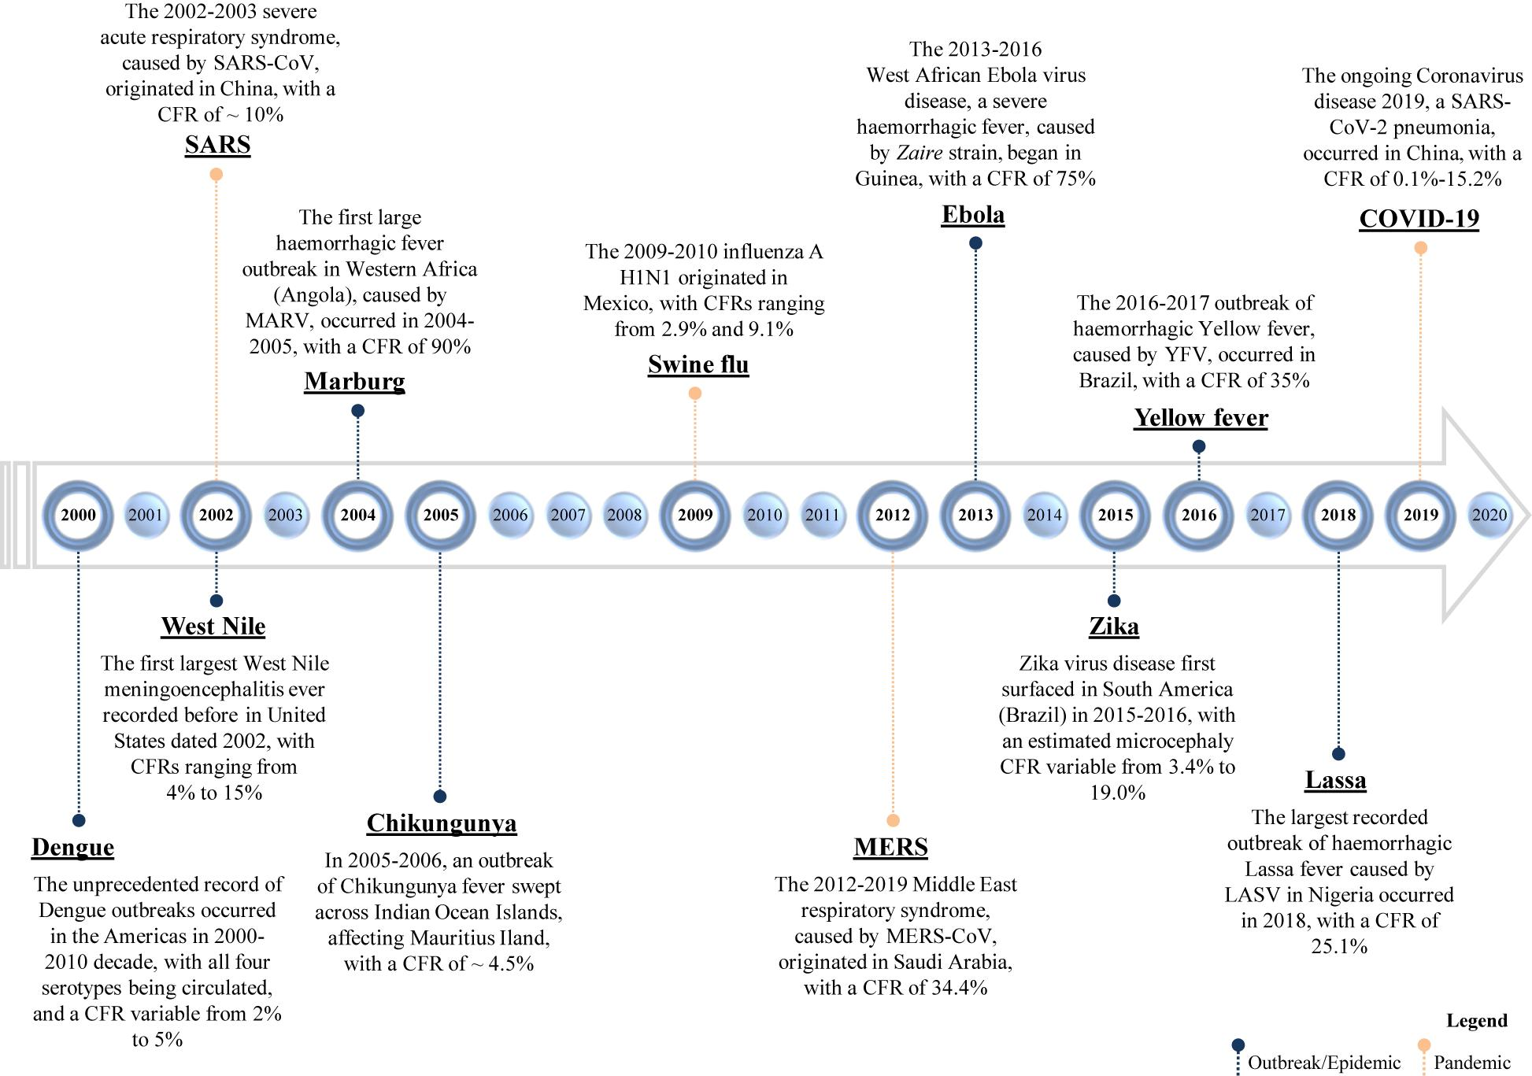
APHS 20203
Epidemiology & Biostatistics
Global Context: Epidemics and Pandemics
GLOBAL CONTEXT
32
Notes:
[Sources]
- Yan Zhang, APHS 20203 W1-Overview and Epi Intro.pptx, source slide 32.
- Inherited epidemics and pandemics timeline as embedded in the source slide.
[/Sources]

Slide 23
APHS 20203
Epidemiology & Biostatistics
Exercise: Apply the Concepts
1
Match each term with the correct example.
A. endemic B. pandemic C. epidemic
Malaria is always present in Africa due to the presence of infected mosquitoes. Malaria is _____ in Africa.
2
Ebola virus cases in parts of Africa exceed what is normally expected for that region. This virus represents an________.
3
COVID-19 spread across countries and continents worldwide. COVID-19 is a_________.
APPLY THE CONCEPTS
33
Notes:
[Sources]
- Yan Zhang, APHS 20203 W1-Overview and Epi Intro.pptx, source slide 33.
[/Sources]

Slide 24
APHS 20203
Epidemiology & Biostatistics
Exercise: Apply the Concepts
1
Match each term with the correct example.
A. endemic B. pandemic C. epidemic
Malaria is always present in Africa due to the presence of infected mosquitoes. Malaria is endemic in Africa.
2
Ebola virus cases in parts of Africa exceed what is normally expected for that region. This virus represents an epidemic.
3
COVID-19 spread across countries and continents worldwide.COVID-19 is a pandemic.
APPLY THE CONCEPTS / ANSWERS
34
Notes:
[Sources]
- Yan Zhang, APHS 20203 W1-Overview and Epi Intro.pptx, source slide 34.
[/Sources]

Slide 25
APHS 20203
Epidemiology & Biostatistics
TRUE OR FALSE
1. A pandemic is always a form of epidemic.
2. An endemic disease always represents an epidemic.
Pause
& think
Exercise: Check Your Understanding
CHECK YOUR UNDERSTANDING
35
Notes:
[Sources]
- Yan Zhang, APHS 20203 W1-Overview and Epi Intro.pptx, source slide 35.
[/Sources]

Slide 26
APHS 20203
Epidemiology & Biostatistics
Exercise: Check Your Understanding
1
1. A pandemic is always a form of epidemic.
• Answer: True
• Explanation: A pandemic is an epidemic that has spread across multiple countries or continents. It still meets the definition of an epidemic—occurrence in excess of what is normally expected—but on a global scale.
2
2. An endemic disease always represents an epidemic.
• Answer: False
• Explanation: An endemic disease is consistently present at an expected level within a population or region. Because it does not exceed normal expectations, it is not considered an epidemic, even though cases may occur continuously.
CHECK YOUR UNDERSTANDING / ANSWERS
36
Notes:
[Sources]
- Yan Zhang, APHS 20203 W1-Overview and Epi Intro.pptx, source slide 36.
[/Sources]

Slide 27
APHS 20203
Epidemiology & Biostatistics
Use of Epidemiology
In this course Epi Group Presentation, you will:
Describe a health problem
(Who is affected? Where? When?)
Explain possible reasons
(Risk factors or exposures)
Interpret evidence
(Patterns and associations)
Propose prevention or control strategies
USE OF EPIDEMIOLOGY
37
Notes:
[Sources]
- Yan Zhang, APHS 20203 W1-Overview and Epi Intro.pptx, source slide 37.
[/Sources]

Slide 28
APHS 20203
Epidemiology & Biostatistics
Revisit Learning objectives
1. Unpack the definition and assumptions of epidemiology
1
Identify epidemiology key events
2
Distinguish between disease distribution patterns: epidemics, endemics, and pandemics
3
Describe at least three uses of epidemiology
LEARNING OBJECTIVES RECAP
38
Notes:
[Sources]
- Yan Zhang, APHS 20203 W1-Overview and Epi Intro.pptx, source slide 38.
[/Sources]

